Slide 1
Selenium using Java

Slide 2
Selenium Goals
Selenium IDE
Locators
Selenium Web Driver
Architecture
Design Patterns
Finding Elements
Working with GUI Controls
TestNG
Selenium Grid
ANT
Jenkins Integration

Slide 3
What Is Test Automation?
The term automation refers to the automatic handling of various industrial processes.
It indicates that there is little to no human intervention.
When we define test automation in the IT sector, it means performing tests on applications via different automation tools to check how applications behave or respond to different actions.
These tools can be both open-source and licensed.
When the application is deployed, a variety of users perform a variety of actions on the application.
Test automation is the process of automating well-known or predictive actions of users to make sure the application behaves as expected.

Slide 4
Basic understanding of test automation framework
In general, a framework is a combination of standards and rules which, when followed, can be used by an enterprise to make the best bang for their buck.
Similarly, a test automation framework is a platform that is a combination of programs, compilers, features, tools, etc.
It provides an environment where you can execute automated test scripts.
In short, a test automation framework is a set of components that facilitate executing tests and comprehensive reporting of test results.
The major components that implement a test automation framework successfully are equipment, testing tools, scripts, procedures, and most importantly, test automation engineers.

Slide 5
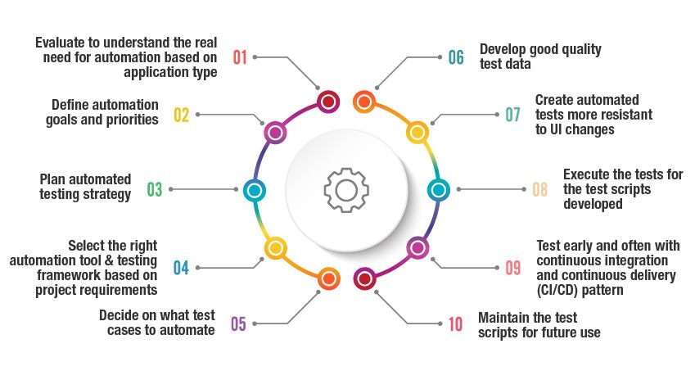
What are the steps for an effective Test Automation Approach?

Slide 6
Importance of Automation Framework in Software Testing
Framework supports automation testing as a technical implementation guideline.
For example, consider a scenario where a testing team includes members who are based on different automation testing code.
And, they are not able to grasp the common pieces of code and scripts updated by a team member in a project.

Slide 7
Importance of Automation Framework in Software Testing
The automation framework not only offers the benefit of reusing the code in various scenarios, but it also helps the team to write down the test script in a standard format.
Hence, the test automation framework handles all the issues.
Besides, there are many other benefits of using automation framework testing as listed below:
Maintain a well-defined strategy across the test suites
Enhanced speed at which testing progresses
Maintaining the test code will be easy
The URL or Application can be tested accurately
Continuous testing of coding and delivery will be achieved

Slide 8
Importance of Automation Framework in Software Testing
Test automation framework is helpful when you need to execute the same test scripts multiple times with different builds to examine the application and validate output.
It is better to avoid automated testing for functionality, which you used only once since building automation script itself is time-consuming.

Slide 9
Test Automation Framework Types
Linear Automation Framework
Modular Driven Framework
Behavior Driven framework
Data-Driven Framework
Keyword-Driven Framework
Hybrid Testing Framework

Slide 10
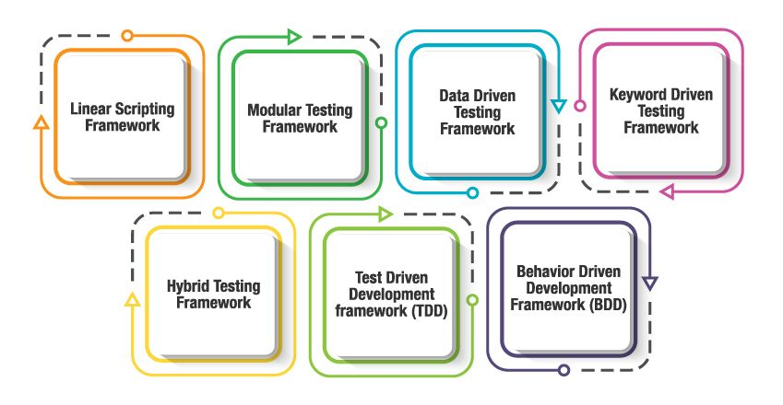
Test Automation Framework Types

Slide 11
Test Automation Framework Types
Linear Automation Framework
The linear Automation framework is commonly used in the testing of small applications.
This framework is also called as a Record and playback framework.
Pros: There is no need to write custom code, so expertise in test automation is not necessary.
Cons: The data is hardcoded in the test script; hence, the test cases cannot be re-run with multiple sets. You need to make some changes if the data is altered.

Slide 12
Test Automation Framework Types
Modular Driven Framework
In this Framework, the tester can create test scripts module wise by breaking down the whole application into smaller modules as per the client requirements and create test scripts individually.
Pros: Modular driven framework ensures the division of scripts that leads to easier maintenance and scalability. You can write independent test scripts.
Cons: The modular driven framework requires additional time in analyzing the test cases and identifying reusable flows.

Slide 13
Test Automation Framework Types
Behavior Driven Development Framework
Behavior Driven Development framework is to create a platform, which allows every person, like Developers, Testers, business analyst, etc., to participate actively.
It also increases collaboration between the tester and the developers on your project.
Pros: You can use non-technical, natural language to create test specifications on this behavior-driven testing.
Cons: To work with this framework, sufficient technical skills as well as prior experience in Test driven development is required.

Slide 14
Test Automation Framework Types
Data-driven Testing Framework
Generally, Test Data is read from the external files like Excel Files, Text Files, CSV Files, ODBC Sources, DAO Objects and they are loaded into the variables inside the Test Script.
The data-driven framework allows us to create test automation scripts by passing different sets of test data.
Pros: It reduces the number of scripts required. Hence, multiple scenarios can be tested in less code.
Cons: You will need a highly experienced tester who should be proficient in various programming languages to completely utilize the design of this framework.

Slide 15
Test Automation Framework Types
The Keyword-Driven Testing Framework
The keyword-Driven Testing framework is also known as table-driven testing.
This framework is suitable only for small projects or applications.
The automation test scripts performed are based on the keywords specified in the excel sheet of the project.
Pros: A single keyword can be used across multiple test scripts, so the code is reusable.
Cons: The initial cost of setting up the framework is high, and it is time-consuming & complex.

Slide 16
Test Automation Framework Types
The Hybrid test Automation Framework
Hybrid Framework is used to combine the benefits of Keyword Driven and Data-Driven frameworks.
Pros: This type leverages the advantages of all kinds of related frameworks.
Cons: Tests are fully scripted in a Hybrid Testing Framework thus increases the automation effort.

Slide 17
How to Choose a Testing Framework
Code or no code
Platform
Budget

Slide 18
What are the types of tests to test automation frameworks?
Before using the testing frameworks, it is important to perform a number of tests on these frameworks which include:
– Functional testing,
– Learning tests,
– Upgradability testing,
– Installability testing,
– Portability testing,
– Interoperability testing,
– Performance testing,
– Suitability testing,
– Syntax testing,
– Usability testing
– Understandability testing along with static analysis

Slide 19
Automation Testing Tools
Ranorex Studio
Ranorex Studio is an all-in-one tool for automating functional UI tests, regression tests, data-driven tests and much more.
Ranorex Studio includes an easy to use click-and-go interface to automate tests for web, desktop, and mobile applications.
Features:
Functional UI and end-to-end testing on desktop, web, and mobile
Cross-browser testing
SAP, ERP, Delphi and legacy applications.
iOS and Android
Run tests locally or remotely, in parallel or distribute on a Selenium Grid
Robust reporting

Slide 20
Automation Testing Tools
Kobiton
Kobiton’s mobile device testing platform offers script-based and scriptless test automation capabilities.
Users can create manual tests that can be re-run automatically across a variety of real devices.
Kobiton fully supports test automation frameworks such as Appium, Espresso and XCTest, while offering its own scriptless test automation through their NOVA AI.

Slide 21
Automation Testing Tools
ZAPTEST
ZAPTEST is a Software Automation solution for any organization that uses software for operations or development, who is looking to automate it’s back-office operations or software testing processes and to develop a seamless and revolving automation framework.
Features:
Functional and Performance Test Automation
RPA (Robotic Process Automation)
Seamless Test+RPA Software Automation
Cross-Platform (Parallel) Execution
DevOps (Mock-ups) Automation
API Testing
Auto-Documentation

Slide 22
Automation Testing Tools
LambdaTest
LambdaTest is one of the most preferred tool to perform automated cross browser testing.
They offer an ultra-fast, scalable and secure selenium grid, which users can utilize and run their tests on 2000+ browsers and OS. It supports all latest and legacy browsers.
Features
Built on latest tech stack, test execution is fast and seamless
Parallel test execution to shorten test cycles
Easy integration with various CI/CD execution, project management, team communication tools.
Users can perform geo location testing and testing of their locally hosted website.
Users can utilize various APIs to extract all data they need
Support for all major languages and framework

Slide 23
Automation Testing Tools
Parasoft Continuous Quality Suite
Parasoft's suite of automated software testing tools integrates quality into the software delivery process for early prevention, detection, and remediation of defects.
Parasoft continuous quality suite covers static code analysis, unit testing and code coverage, API testing and service virtualization, and UI testing, enabling delivery at speed and compliance with industry and security standards.

Slide 24
Automation Testing Tools
Features:
AI-powered test creation and execution
Low-code application testing
Extensive dashboards for quality reporting and analysis
Support for 120+ message formats and protocols
Integration with CI/CD pipeline and Agile DevOps workflows

Slide 25
Automation Testing Tools
Selenium
It is a software testing tool used for Regression Testing.
It is an open-source testing tool that provides playback and recording facility for Regression Testing.
The Selenium IDE only supports Mozilla Firefox web browser.
It provides the provision to export recorded script in other languages like Java, Ruby, RSpec, Python, C#, etc
It can be used with frameworks like JUnit and TestNG
It can execute multiple tests at a time
Autocomplete for Selenium commands that are common
Walkthrough tests

Slide 26
Automation Testing Tools
Identifies the element using id, name, X-path, etc.
Store tests as Ruby Script, HTML, and any other format
It provides an option to assert the title for every page
It supports selenium user-extensions.js file
It allows to insert comments in the middle of the script for better understanding and debugging

Slide 27
What Is Selenium Automation Framework?
Selenium is a leading test automation framework that is portable and is used for testing web applications.
This tool provides a record and playback feature for authoring functional tests.
Some of the other test automation frameworks effectively used by testers are the integration testing framework, UI testing framework and more commonly used are the keyword driven frameworks.
Based on the application under test, these testing frameworks should be chosen to get the complete advantage of using these best test automation frameworks.

Slide 28
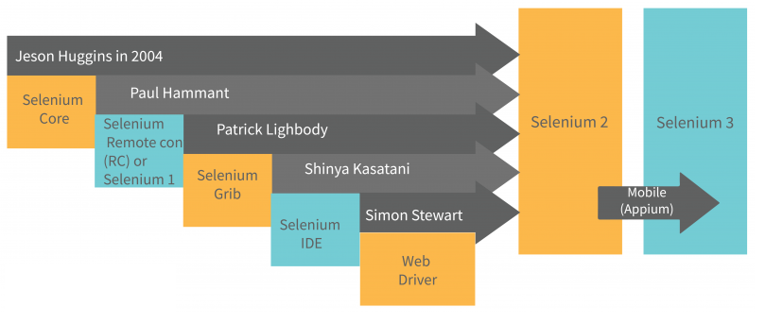
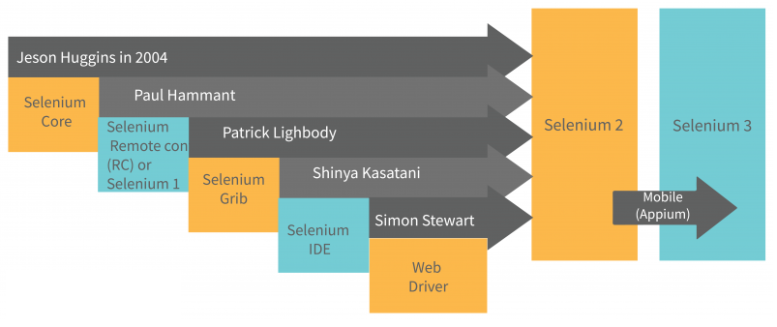
Understanding the Selenium components

Slide 29
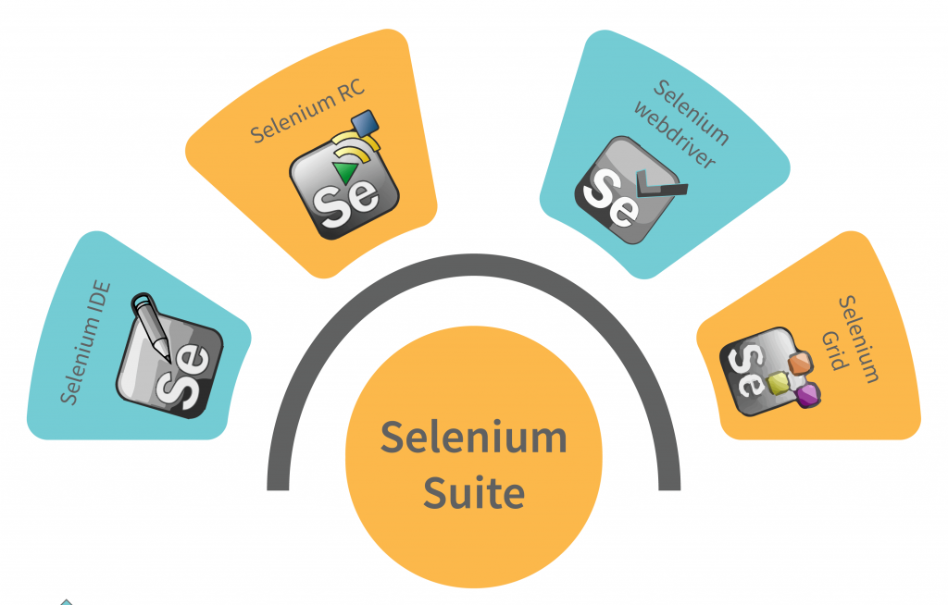
Understanding the Selenium components

Slide 30
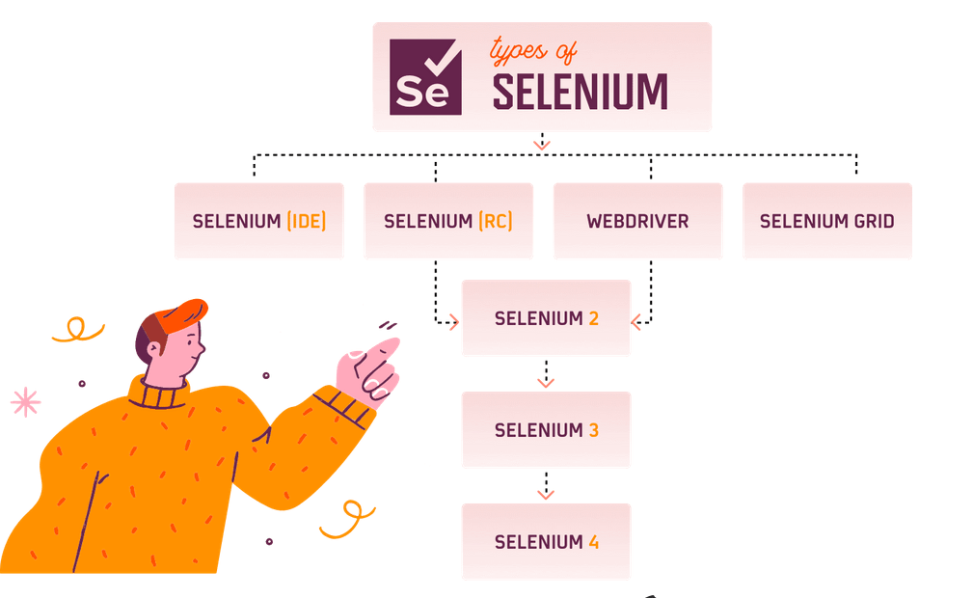
Understanding the Selenium components

Slide 31
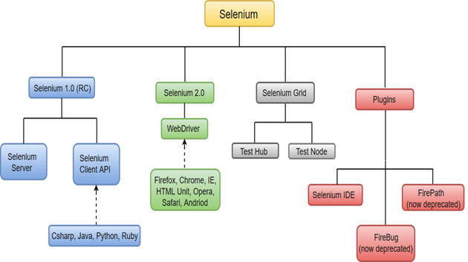
Understanding the Selenium components

Slide 32
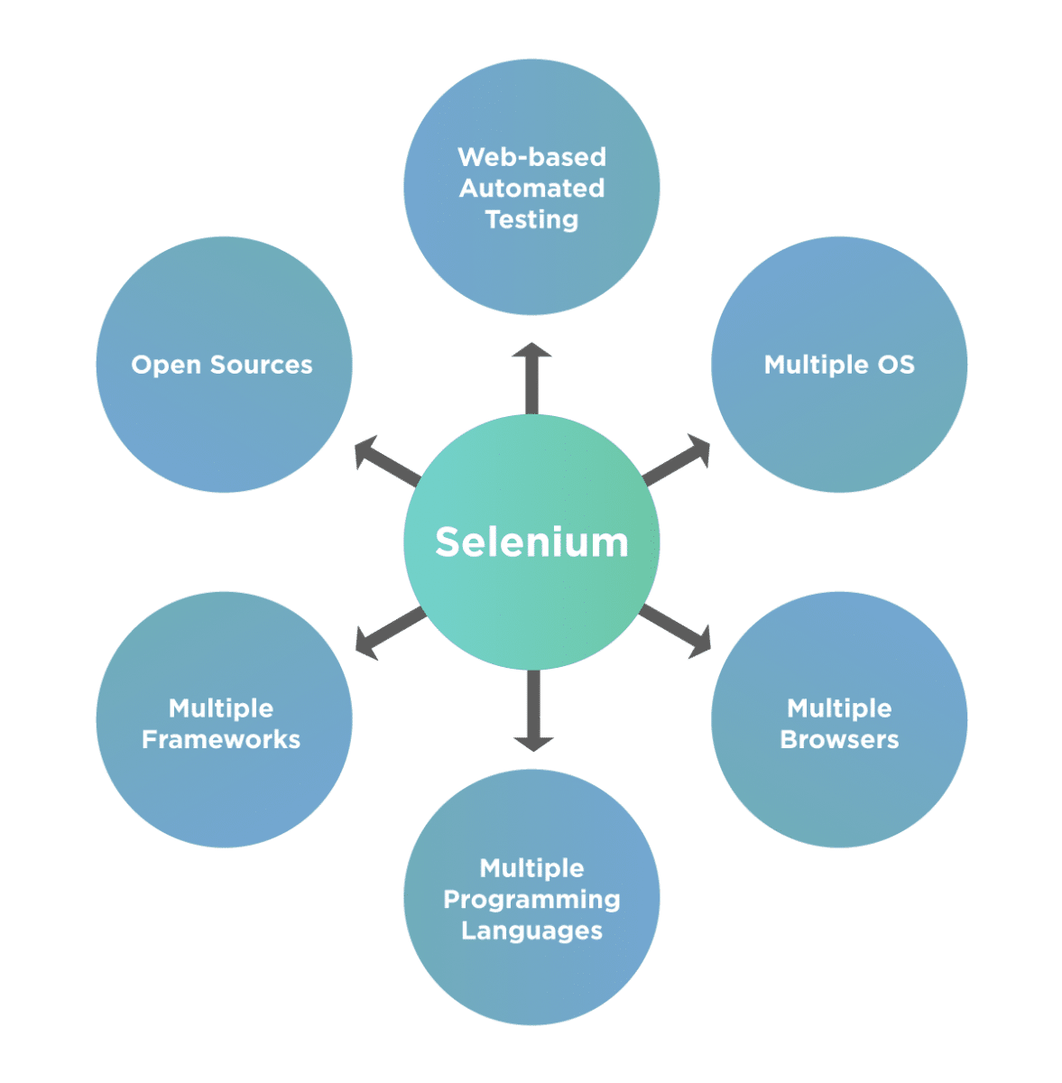
Why Selenium

Slide 33
Getting Started with Selenium IDE
A set of tools that supports rapid development of test automation for web-based applications.
Can be recorded and written as HTML
Support for a number of programming languages: Java, C#, Perl, PHP, Python, Ruby
Cross browsers support: IE, Firefox, Opera, Safari and Google Chrome
Cross platform support: Windows, Linux, and Macintosh.

Slide 34
Getting Started with Selenium IDE
Invented in 2004 by Jason R. Huggins and team.
Originally named JavaScript Functional Tester [JSFT] 100% Javascript and HTML
Designed to make test writing easy
Open-source browser-based integration test framework built originally by ThoughtWorks
Selenium is open-source software, released under the Apache 2.0 license and can be downloaded and used without charge.

Slide 35
Getting Started with Selenium IDE
Selenium IDE is a Firefox Add-on developed originally by Shinya Kasatani as a way to use the original Selenium Core code without having to copy Selenium Core onto the server.
Selenium Core is the key JavaScript modules that allow Selenium to drive the browser.
It has been developed using JavaScript so that it can interact with DOM (Document Object Model) using native JavaScript calls.
Selenium IDE was developed to allow testers and developers to record their actions as they follow the workflow that they need to test.

Slide 36
Installing Selenium IDE
1. Go to http://seleniumhq.org/download/.
2. Click on the download link for Selenium IDE. You may see a message appear saying Firefox prevented this site (seleniumhq.org) from asking you to install software on your computer. If you do, click the Allow button.

Slide 37
Installing Selenium IDE
Once the install process is complete it will ask you to restart Firefox.
Click the Restart Now button. Firefox will close and then re-open.
If you have anything open in another browser it might be worth saving your work, as Firefox will try to go back to its original state but this cannot be guaranteed.

Slide 38
Selenium IDE

Slide 39
Selenium IDE

Slide 40
Selenium IDE

Slide 41
Selenium IDE

Slide 42
Rules for automation
Tests should always have a known starting point.
In the context of Selenium, this could mean opening a certain page to start a workflow.
Tests should not have to rely on any other tests to run. If a test is going to add something, do not have a separate test to delete it.
This is to ensure that if something goes wrong in one test, it will not mean you have a lot of unnecessary failures to check.
Tests should only test one thing at a time.
Tests should clean up after themselves.

Slide 43
Recording your first test with Selenium IDE
To start recording the tests we will need to start Mozilla Firefox.
Once it has been loaded, you will need to start Selenium IDE.
You will find it under the Tools dropdown menu in Mozilla Firefox or in the Web Developer dropdown menu.
Once loaded it will look like the next screenshot. Note that the record button is engaged when you first load the IDE.

Slide 44
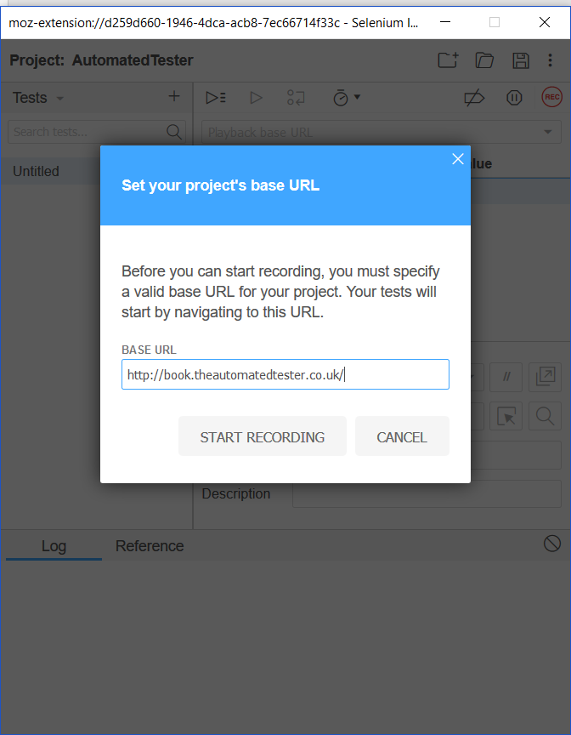
Recording your first test with Selenium IDE

Slide 45
verify and assert methods
 verifyElementPresent
 assertElementPresent
 verifyElementNotPresent
 assertElementNotPresent
 verifyText
 assertText
 verifyAttribute
 assertAttribute
 verifyChecked
 assertChecked
 verifyAlert
 assertAlert
 verifyTitle
 assertTitle

Slide 46
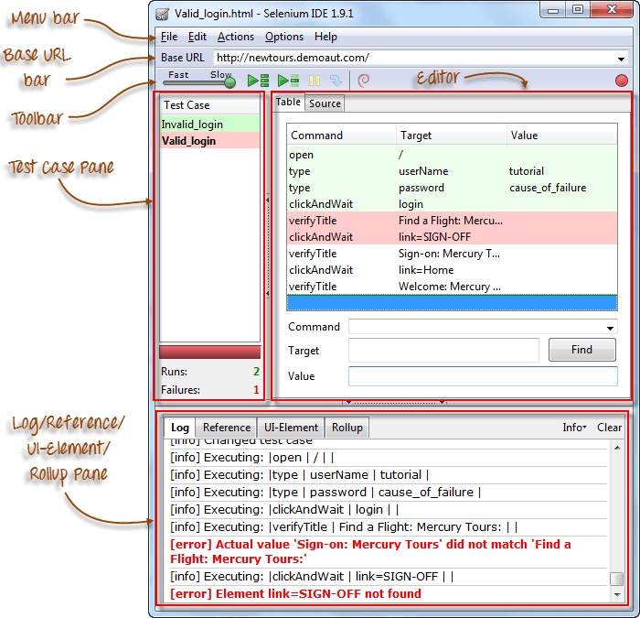
Selenium IDE

Slide 47
Introduction to Selenium Commands - Selenese
3 Types of Commands
Actions | These are commands that directly interact with page elements. Example: the "click" command is an action because you directly interact with the element you are clicking at. The "type" command is also an action because you are putting values into a text box, and the text box shows them to you in return. There is a two-way interaction between you and the text box.

Slide 48
Introduction to Selenium Commands - Selenese
3 Types of Commands
Accessors | They are commands that allow you to store values to a variable. Example: the "storeTitle" command is an accessor because it only "reads" the page title and saves it in a variable. It does not interact with any element on the page.

Slide 49
Introduction to Selenium Commands - Selenese
3 Types of Commands
Assertions | They are commands that verify if a certain condition is met. 3 Types of Assertions Assert. When an "assert" command fails, the test is stopped immediately. Verify. When a "verify" command fails, Selenium IDE logs this failure and continues with the test execution. WaitFor. Before proceeding to the next command, "waitFor" commands will first wait for a certain condition to become true. If the condition becomes true within the waiting period, the step passes. If the condition does not become true, the step fails. Failure is logged, and test execution proceeds to the next command. By default, the timeout value is set to 30 seconds. You can change this in the Selenium IDE Options dialog under the General tab.

Slide 50
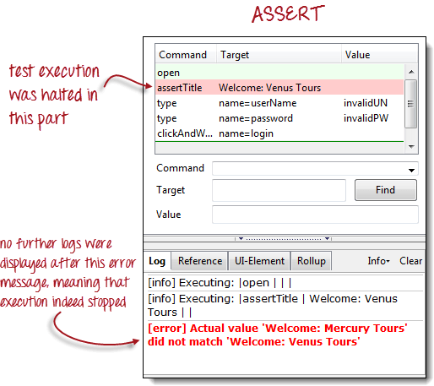

Slide 51
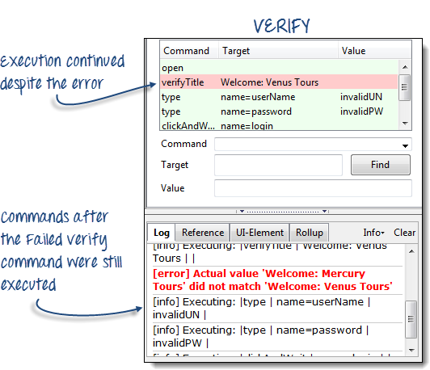

Slide 52
Command | Number of Parameters | Description
open | 0 - 2 | Opens a page using a URL.
click/clickAndWait | 1 | Clicks on a specified element.
type/typeKeys | 2 | Types a sequence of characters.
verifyTitle/assertTitle | 1 | Compares the actual page title with an expected value.
verifyTextPresent | 1 | Checks if a certain text is found within the page.
verifyElementPresent | 1 | Checks the presence of a certain element.
verifyTable | 2 | Compares the contents of a table with expected values.
waitForPageToLoad | 1 | Pauses execution until the page is loaded completely.
waitForElementPresent | 1 | Pauses execution until the specified element becomes present.

Slide 53
Locators
Locators allow us to find elements on a page that can be used in our tests.
Locate elements by ID
 Locate elements by Name
 Locate elements by Link
 Locate elements by XPath
 Locate elements by CSS
 Locate elements by DOM

Slide 54
Locating elements by ID
On web applications today, elements should have an ID attribute for all their controls on the page.
A control would be an element that we can interact with and is not static text.
This allows Selenium to find the unique item, since IDs should be unique, and then complete the action that it needs to do against that element.

Slide 55
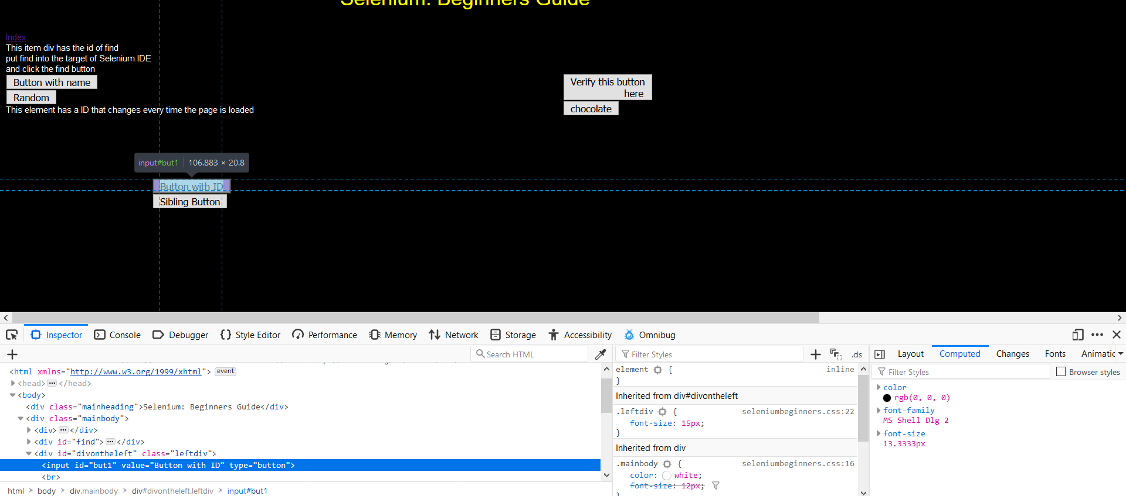
Locating elements by ID

Slide 56
Locating elements by ID

Slide 57
finding elements by name

Slide 58
Adding filters to the name
There are times when there may be elements on the page that have the same name but a different attribute.
When this happens we can apply filters to the locator so that Selenium IDE can find the element that we are after.

Slide 59
finding elements by link text
Probably the most common element on a page is a link.
Links allow pages to be joined together so end users can navigate your site with confidence.
You can see a screenshot of the element being found in Selenium IDE.

Slide 60
finding elements by accessing the DOM via JavaScript
There are times where the DOM will be updated via AJAX and this means that our locator needed for the test will need some form of JavaScript to see if it is there.
In JavaScript, calling the DOM to find the first link on the page would look like document.links[0];. document represents the HTML document and links is an array on that object.

Slide 61
finding elements by XPath
XPath allows us to query the DOM as though it were an XML document.
With XPath we can do some rather complex queries to find elements on the page that may not have been accessible otherwise.

Slide 62
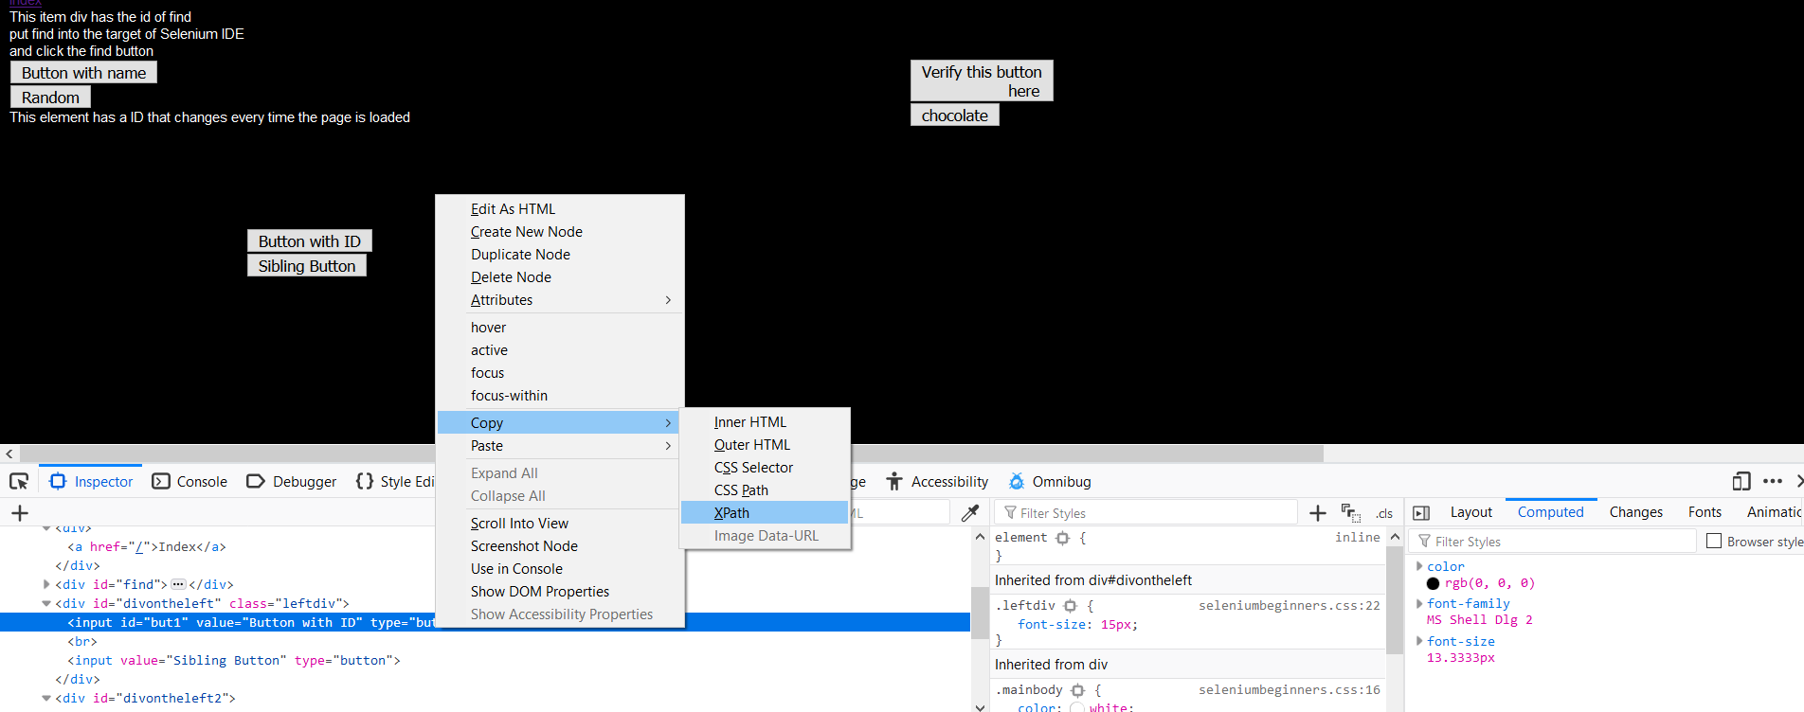
finding elements by XPath

Slide 63
Finding an element by the text it contains
Finding elements by the text they contain can be quite useful when working with web pages that have been created dynamically.
The elements could be from using a web based WYSIWYG editor or you might just like to find a paragraph on the page with specific text to then do further queries on.
To do this your query will need to have the text() method call in the query.
It will match the entire contents of the node if it has the format //element[text()='inner text'].

Slide 64
Finding an element by the text it contains

Slide 65
Finding an element by the text it contains

Slide 66
CSS selectors
So, finding elements by XPath can be an extremely costly exercise.
A way around this is to use CSS selectors to find the objects that you need. Selenium is compatible with CSS 1.0, CSS 2.0, and CSS 3.0 selectors.
There are a number of items that are supported like namespace in CSS 3.0 and some pseudo classes and pseudo elements.

Slide 67
CSS selectors

Slide 68
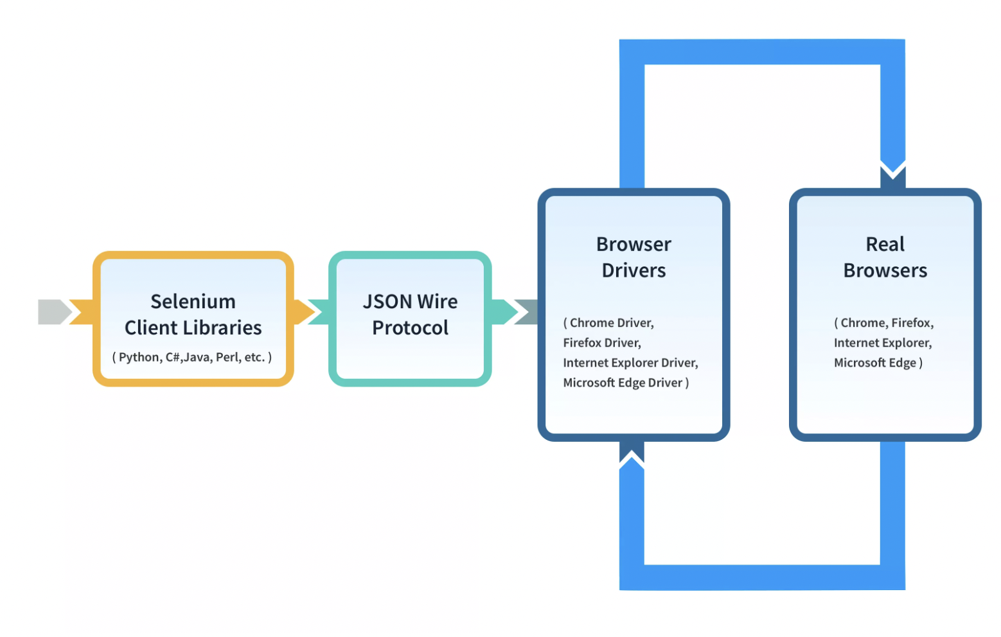
Selenium WebDriver- Architecture (selenium-3)
In Selenium 3, there is no direct communication between the client libraries (Java, Python, JavaScript, etc) and the browser drivers.
The server (browser drivers) does not understand language but only the protocols and on the other hand, client libraries does not understand protocols used by browser drivers.

Slide 69
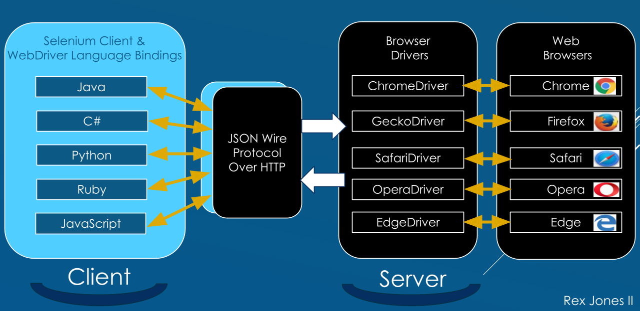
Selenium WebDriver- Architecture (selenium-3)

Slide 70
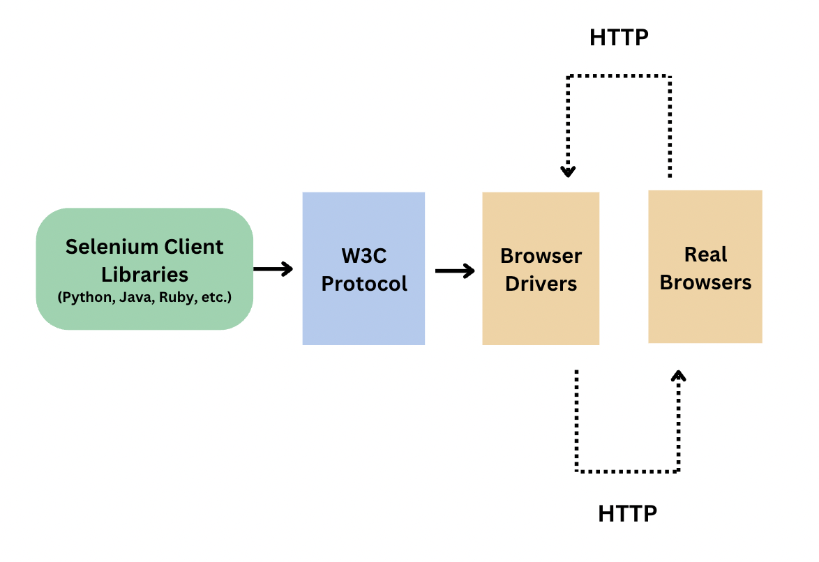
Selenium WebDriver- Architecture (selenium-4)
Selenium 4 WebDriver was made W3C compliant to make the communication easy and direct between the client libraries and the browser drivers. Improved communication led to more stability.

Slide 71
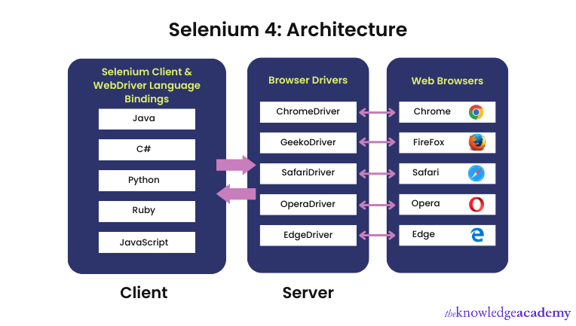
Selenium WebDriver- Architecture (selenium-4)

Slide 72
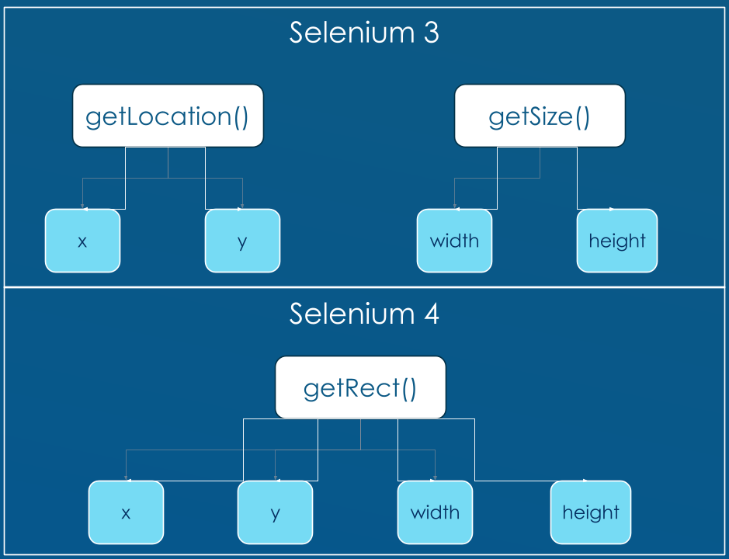
Selenium WebDriver- Architecture (selenium-4)

Slide 73
Selenium WebDriver- Architecture
WebDriver Architecture is made up of four major components:
Selenium Client library
JSON wire protocol over HTTP
Browser Drivers
Browsers

Slide 74
Selenium WebDriver
WebDriver on the other hand tries to control the browser from outside the browser.
It uses accessibility API to drive the browser.
The accessibility API is used by a number of applications for accessing and controlling applications when they are used by disabled users and is common to web browsers.
WebDriver uses the most appropriate way to access the accessibility API.
If we look at Firefox, it uses JavaScript to access the API.
If we look at Internet Explorer, it uses C++.
This approach means we can control browsers in the best possible way but has the downside that new browsers entering the market will not be supported straight away like we can with Selenium RC.

Slide 75
WebDriver API
The WebDriver API is the part of the system that you interact with all the time.
Things have changed from the 140-line long API that the Selenium RC API had.
This is now more manageable and can fit on a normal screen.
This is made up of the WebDriver and the WebElement objects.
driver.findElement(By.name("q"))
&
element.sendKeys("I love cheese");
These commands are then translated to the SPI, which is stateless.

Slide 76
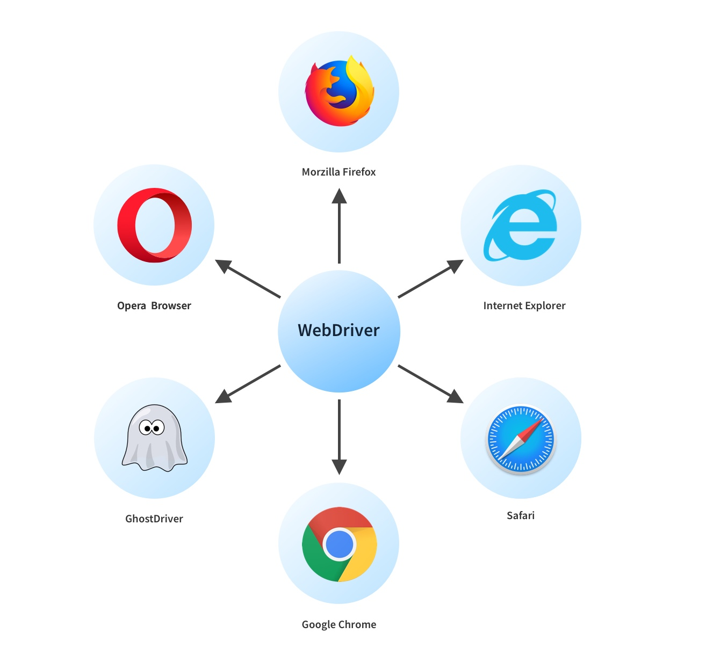
Selenium WebDriver- Features

Slide 77
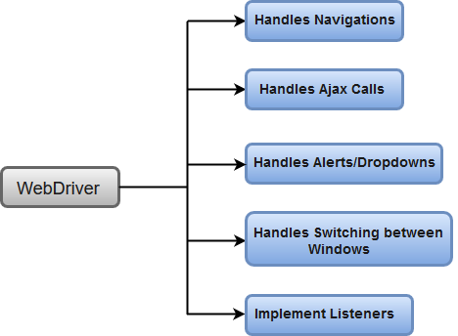
Selenium WebDriver- Features

Slide 78
Basic Steps in a Selenium WebDriver Script
Create a WebDriver instance.
Navigate to a webpage.
Locate a web element on the webpage via locators in selenium.
Perform one or more user actions on the element.
Preload the expected output/browser response to the action.
Run test.
Record results and compare results from them to the expected output.

Slide 79
Selenium WebDriver- Installation
Selenium WebDriver installation process is completed in four basic steps:
Download and Install Java 11 or higher version.
Download and configure Eclipse or any Java IDE of your choice.
Download Selenium WebDriver Java Client
Open URL: https://docs.seleniumhq.org/download/
Configure Selenium WebDriver

Slide 80
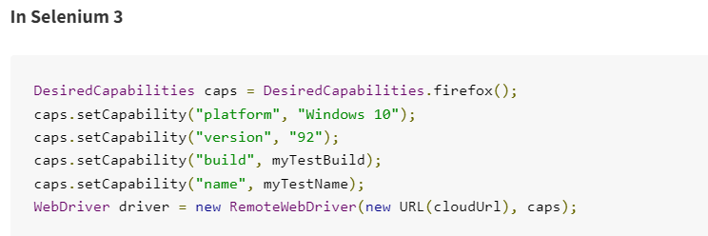
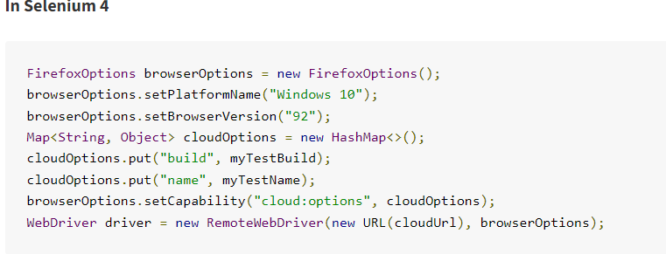
Selenium 3 vs 4

Slide 81
Different Types of Locators in Selenium
By CSS ID: find_element_by_id
By CSS class name: find_element_by_class_name
By name attribute: find_element_by_name
By DOM structure or Xpath: find_element_by_xpath
by tagName: find_element_by_tag_name()
By link text: find_element_by_link_text
By partial link text: find_element_by_partial_link_text
By HTML tag name: find_element_by_tag_name

Slide 82
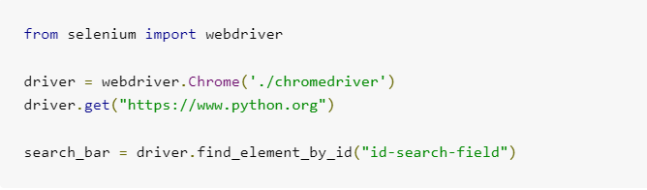
Locate Elements by CSS ID

Slide 83
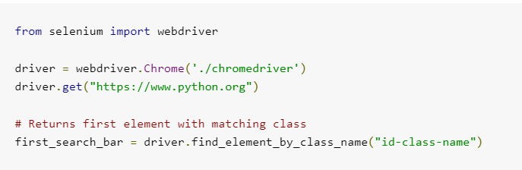
Locate Elements by CSS Class

Slide 84
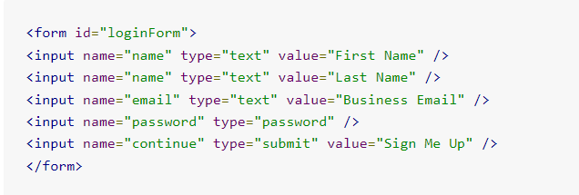
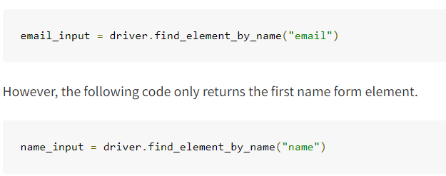
Locate Elements by Name

Slide 85
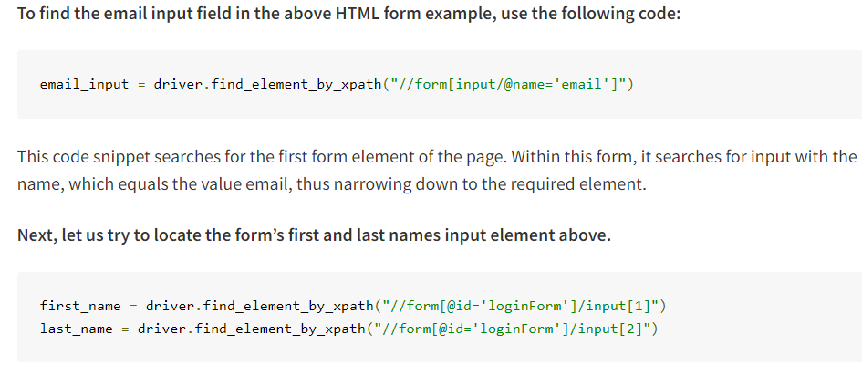
Locate Elements by XPath

Slide 86
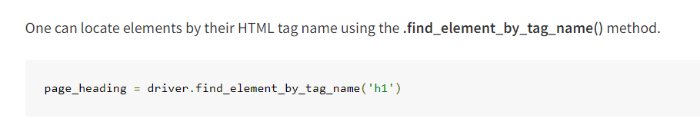
Locate Elements by tagName

Slide 87
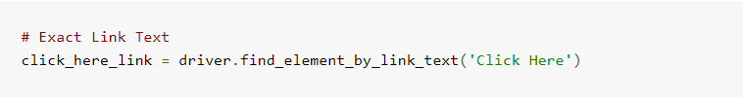
Locate Elements by linkText

Slide 88
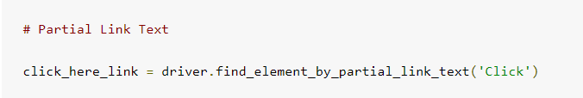
Locate Elements by partialLinkText

Slide 89
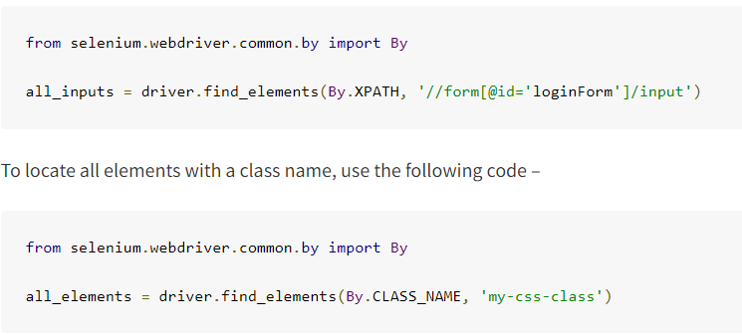
Locate Multiple Elements

Slide 90
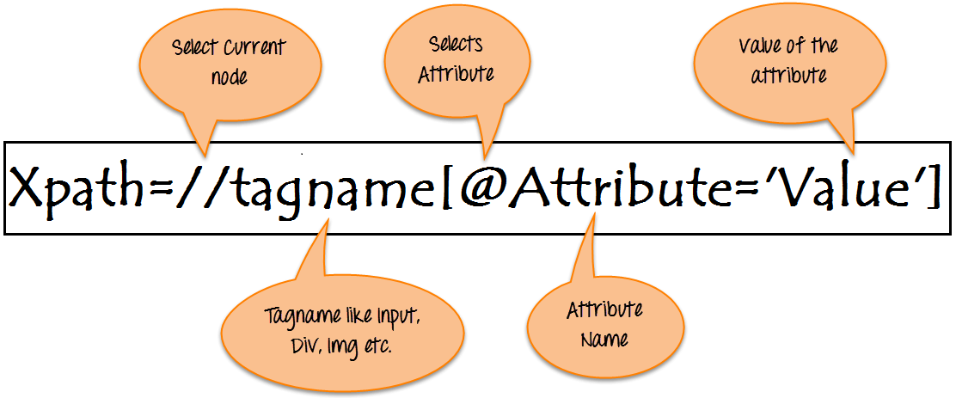
Locate By XPath

Slide 91
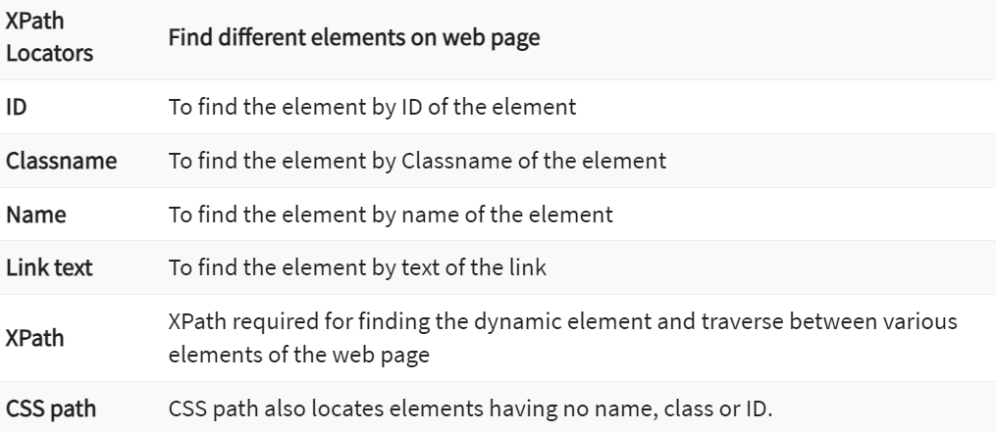
Locate By XPath

Slide 92
How To Write Dynamic XPath In Selenium WebDriver
Basic XPath:
Xpath=//input[@name='uid’]
<input name=“uid” />
Xpath=//input[@type='text’]
<input type=“text”>
Xpath=//label[@id='message23’]
<label id=“message23”>
Xpath=//input[@value='RESET’]
<input value=“RESET”>
Xpath=//*[@class='barone’]
<p class=“barone>, <div class=“barone”>, <form class=“barone”>
Xpath=//a[@href='http://demo.guru99.com/’]
<a href=“'http://demo.guru99.com/”></a>
Xpath=//img[@src='//guru99.com/images/home/java.png’]
<img src=“='//guru99.com/images/home/java.png”/>

Slide 93
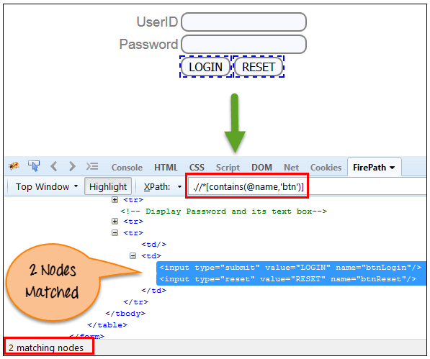
How To Write Dynamic XPath In Selenium WebDriver
Contains():
Xpath=//*[contains(@name,'btn')]

Slide 94
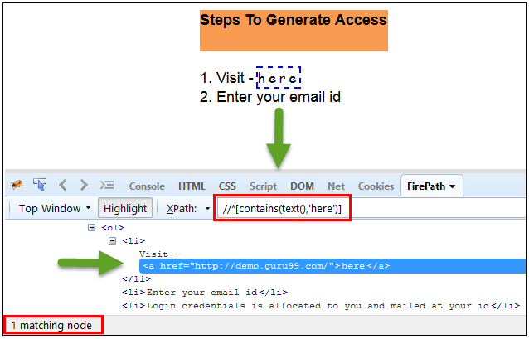
How To Write Dynamic XPath In Selenium WebDriver
Contains():
Xpath=//*[contains(text(),'here')]
Xpath=//*[contains(@href,'guru99.com')]

Slide 95
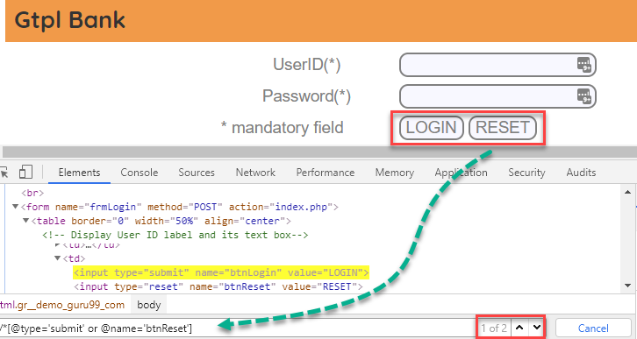
How To Write Dynamic XPath In Selenium WebDriver
Using OR & AND:
Xpath=//*[@type='submit' or @name='btnReset']

Slide 96
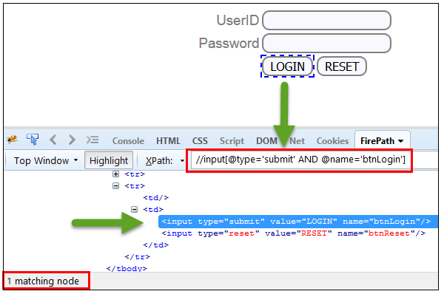
How To Write Dynamic XPath In Selenium WebDriver
Using OR & AND:
Xpath=//input[@type='submit' and @name='btnLogin']

Slide 97
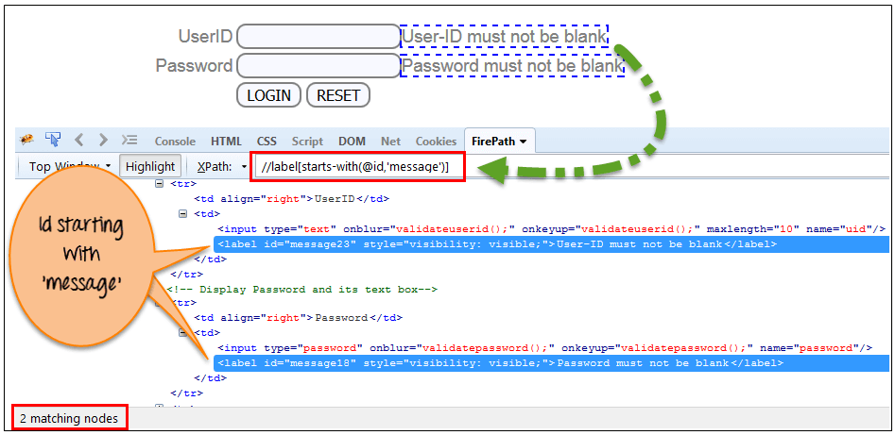
How To Write Dynamic XPath In Selenium WebDriver
Xpath Starts-with
Xpath=//label[starts-with(@id,'message')]

Slide 98
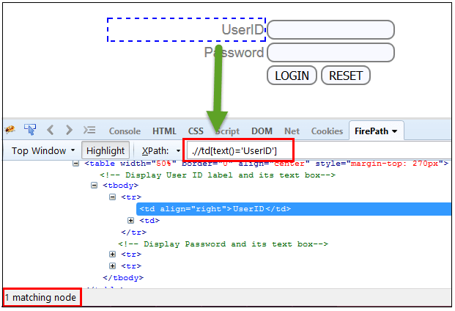
How To Write Dynamic XPath In Selenium WebDriver
XPath Text() Function
Xpath=//td[text()='UserID']

Slide 99
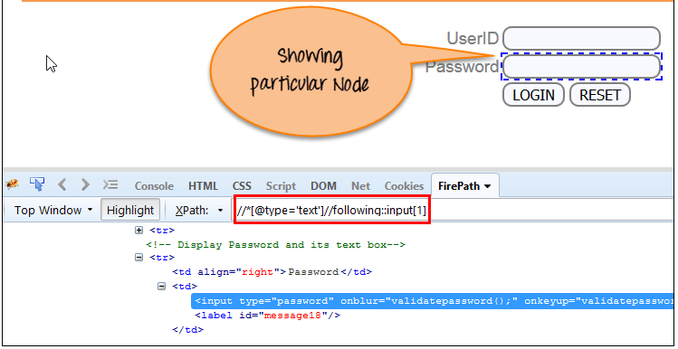
How To Write Dynamic XPath In Selenium WebDriver
XPath axes methods
Following:
Xpath=//*[@type='text']//following::input[1]

Slide 100
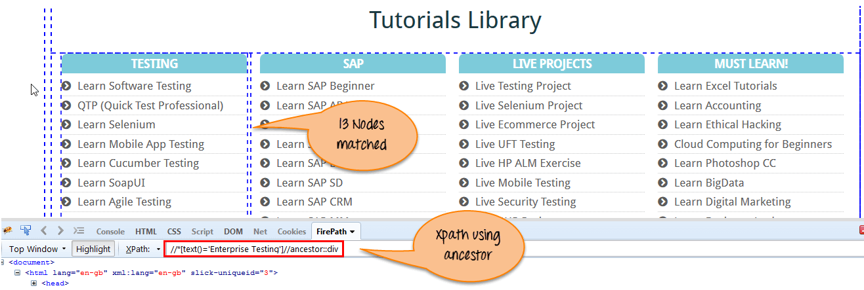
How To Write Dynamic XPath In Selenium WebDriver
XPath axes methods
Ancestor:
Xpath=//*[text()='Enterprise Testing']//ancestor::div

Slide 101
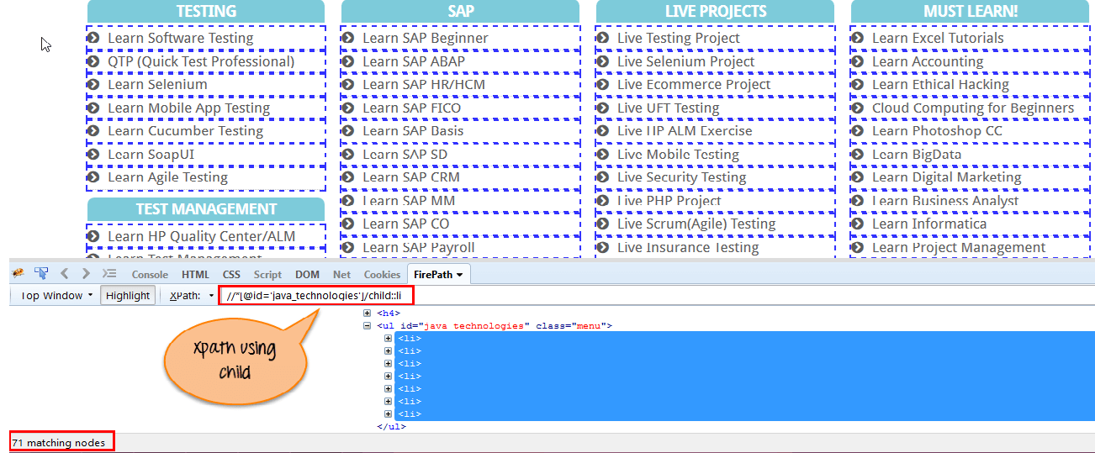
How To Write Dynamic XPath In Selenium WebDriver
XPath axes methods
child:
Xpath=//*[@id='java_technologies']//child::li

Slide 102
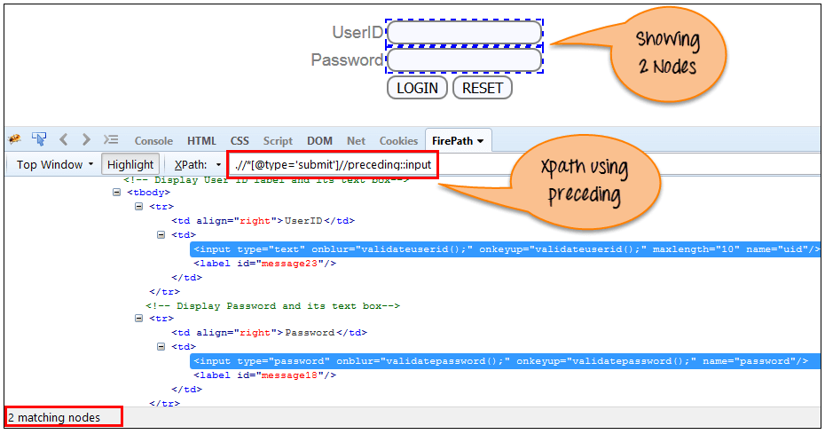
How To Write Dynamic XPath In Selenium WebDriver
XPath axes methods
Preceding:
Xpath=//*[@type='submit']//preceding::input

Slide 103
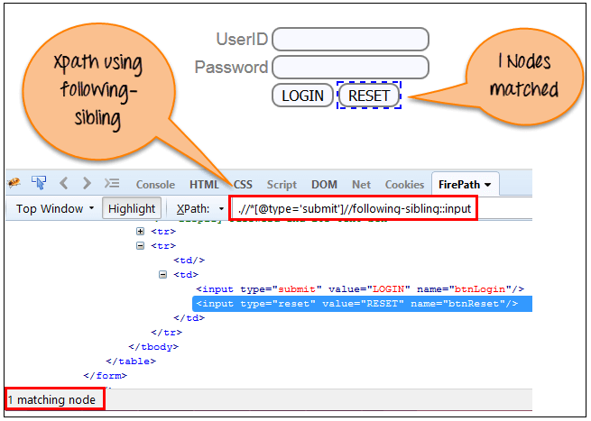
How To Write Dynamic XPath In Selenium WebDriver
XPath axes methods
Following-sibling:
xpath=//*[@type='submit']//following-sibling::input

Slide 104
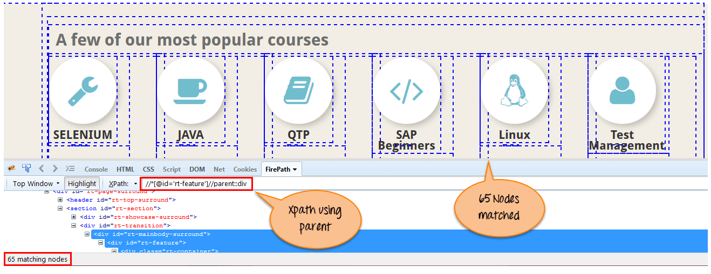
How To Write Dynamic XPath In Selenium WebDriver
XPath axes methods
Parent:
Xpath=//*[@id='rt-feature']//parent::div

Slide 105
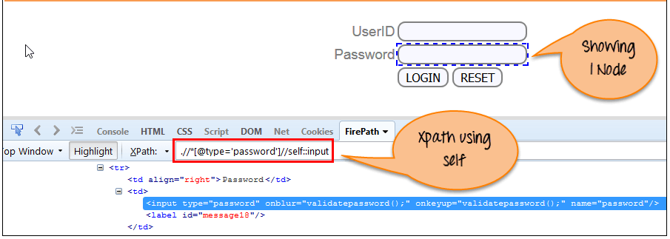
How To Write Dynamic XPath In Selenium WebDriver
XPath axes methods
Self:
Xpath =//*[@type='password']//self::input

Slide 106
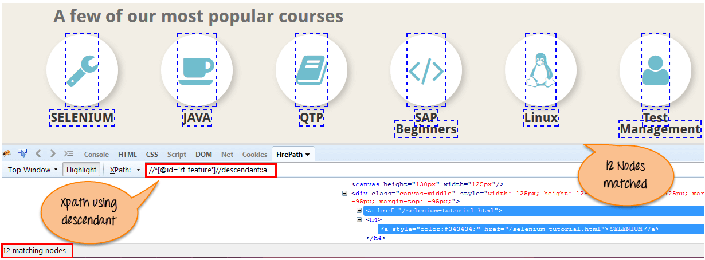
How To Write Dynamic XPath In Selenium WebDriver
XPath axes methods
Descendant:
Xpath=//*[@id='rt-feature']//descendant::a

Slide 107
Selenium3 vs Selenium 4
Relative Locators
import static org.openqa.selenium.support.locators.RelativeLocator.with;

Slide 108
Selenium3 vs Selenium 4
#1) Capture screenshot of specific web element:
Earlier, users can take a screenshot of the entire page as there was no provision to take the screenshot of the specific web element. But with Selenium 4, users can take the screenshot of a specific web element.
Please find the below code:
WebElement logo=driver.Findelement (By.xpath(“//div[@id=’divLogo’]//img”));
File file=logo.getScreenshotAs(OutputType.FILE);
File destFile =new File(“logo.png”);
FileUtils.copyFile(file,destfile);

Slide 109
Selenium3 vs Selenium 4
#2) Open the new tab on the browser:
Now, in Selenium 4, the user can open a URL in a new tab along with the existing tab.
For Example: If the user wants to open 2 URLs in two different tabs at the same time, the user can do that with the Selenium 4.
Please find the below code for reference:
driver.get(https://www.google.com/);
driver.switchTo().newWindow(WindowType.TAB);
driver.navigate().to(https://www.crmpro.com/);

Slide 110
Selenium3 vs Selenium 4
#3 Open a new window on the browser:
Using Selenium 4, the users can also open the new window on the same browser.
For Example, if the user wants to access two applications in the same browser, the user can now do this.
Please find the below code for reference:
driver.get(https://www.google.com/);
driver.switchTo().newWindow(WindowType.WINDOW);
driver.navigate().to(https://www.crmpro.com/);

Slide 111
Selenium3 vs Selenium 4
#4 Object Location:
Now with Selenium 4, users can achieve the coordinates, dimension, height, width, etc. as the location of the web elements or object.
Please find the below code for your reference:
WebElement logo1=driver.Findelement(By.xpath(“//div[@id=’divLogo’]//img”));
System.out.println(“Height:” +logo.getRect().getDimension().getHeight());
System.out.println(“Height:” +logo.getRect().getDimension().getWidth());
System.out.println(“X Location: “ +logo.getRect().getX());
System.out.println(“Y Location: “ +logo.getRect().getY());

Slide 112
Selenium3 vs Selenium 4
#5 Relative Locators
above(): It is to locate a web element just above the specified element
below(): It is to locate a web element just below the specified element
toLeftOf(): It is to locate a web element present on the left of a specified element
toRightOf(): It is to locate a web element present on the right of a specified element
near(): It is to locate a web element at approx. 50 pixels away from a specified element. The distance can be passed as an argument to an overloaded method.

Slide 113
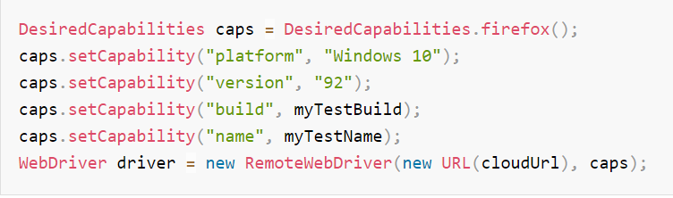
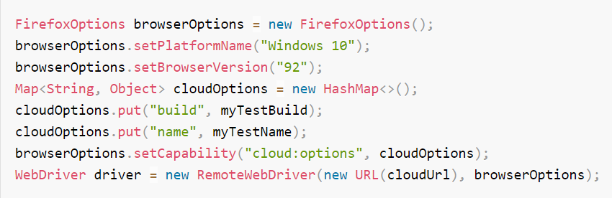
Selenium3 vs Selenium 4
Selenium 3
Selenium 4

Slide 114

Selenium3 vs Selenium 4
Find element(s) utility methods in Java

Slide 115

Selenium3 vs Selenium 4
Find element(s) utility methods in Java

Slide 116
Selenium3 vs Selenium 4
Wait and Timeout (Before)
driver.manage().timeouts().implicitlyWait(10, TimeUnit.SECONDS);
driver.manage().timeouts().setScriptTimeout(2, TimeUnit.MINUTES);
driver.manage().timeouts().pageLoadTimeout(10, TimeUnit.SECONDS);

Slide 117
Selenium3 vs Selenium 4
Wait and Timeout (After)
driver.manage().timeouts().implicitlyWait(Duration.ofSeconds(10));
driver.manage().timeouts().scriptTimeout(Duration.ofMinutes(2));
driver.manage().timeouts().pageLoadTimeout(Duration.ofSeconds(10));

Slide 118
Selenium3 vs Selenium 4
Wait and Timeout (Before)
new WebDriverWait(driver, 3)
.until(ExpectedConditions.elementToBeClickable(By.cssSelector("#id")));
Wait<WebDriver> wait = new FluentWait<WebDriver>(driver)
.withTimeout(30, TimeUnit.SECONDS)
.pollingEvery(5, TimeUnit.SECONDS)
.ignoring(NoSuchElementException.class);

Slide 119
Selenium3 vs Selenium 4
Wait and Timeout (After)
new WebDriverWait(driver, Duration.ofSeconds(3)) .until(ExpectedConditions.elementToBeClickable(By.cssSelector("#id")));
Wait<WebDriver> wait = new FluentWait<WebDriver>(driver)
.withTimeout(Duration.ofSeconds(30))
.pollingEvery(Duration.ofSeconds(5))
.ignoring(NoSuchElementException.class);

Slide 120
Web Driver API
Read Browser Details:
driver.getTitle();
driver.getWindowHandle();
driver.getWindowHandles();
driver.getCurrentUrl();
driver.getPageSource();

Slide 121
Web Driver API
Go to a specified URL:
driver.get(“http://google.com”)
driver.navigate().to(“http://google.com”)
driver.navigate().to(new URL(“http://google.com”))
driver.navigate().back()
driver.navigate().forward()
driver.navigate().refresh()

Slide 122
Web Driver API
driver.findElement(By) – To find the first element matching the given locator argument. Returns a WebElement
driver.findElements(By) – To find all elements matching the given locator argument. Returns a list of WebElement

Slide 123
Web Driver API
By ID
<input id=”q” type=”text”>…</input>
WebElement element = driver.findElement(By.id(“q”))
By Name
<input id=”q” name=”search” type=”text” />
WebElement element = driver.findElement(By.name(“search”));
By Class Name
<div class=”username” style=”display: block;”>…</div>
WebElement element = driver.findElement(By.className(“username”));
By Tag Name
<div class=”username” style=”display: block;”>…</div>
WebElement element = driver.findElement(By.tagName(“div”));

Slide 124
Web Driver API
By Link Text
<a href=”#”>Refresh</a>
WebElement element = driver.findElement(By.linkText(“Refresh”));
By Partial Link Text
<a href=”#”>Refresh Here</a>
WebElement element = driver.findElement(By.partialLinkText(“Refresh”));
By XPath
<form id=”testform” action=”submit” method=”get”>
Username: <input type=”text” />
Password: <input type=”password” />
</form>

Slide 125
Web Driver API
WebElement element = driver.findElement(By.xpath(“//form[@id=’testform’]/input[1]”));
By CSS Selector
<form id=”testform” action=”submit” method=”get”>
<input class=”username” type=”text” />
<input class=”password” type=”password” />
</form>
WebElement element = driver.findElement(By.cssSelector(“form#testform>input.username”));

Slide 126
Web Driver API
Java Selenium commands for operation on Elements:
button/link/image:
click() getAttribute() isDisplayed() isEnabled()
Text field:
sendKeys() clear()
Checkbox/Radio:
isSelected() click()

Slide 127
Web Driver API
Select:
Select select = new Select(WebElement);
select.selectByIndex();
select.selectByValue();
select.selectByVisibleText();
select.deselectAll();
select.deselectByIndex();
select.deselectByValue();
select.deselectByVisibleText();
getFirstSelectedOption()
getAllSelectedOptions() – Returns List

Slide 128
Web Driver API
Element properties:
isDisplayed()
isSelected()
isEnabled()
Read Attribute:
getAttribute(“”)
Get attribute from a disabled text box
driver.findElement(By).getAttribute(“value”);

Slide 129
Web Driver API
Screenshot:
image storage without using any extra libraries.
TakesScreenshot takeScreenshot = (TakesScreenshot) driver;
File file = takeScreenshot.getScreenshotAs(OutputType.FILE);
FileInputStream fis = new FileInputStream(file);
FileOutputStream fos = new FileOutputStream(new File(System.getProperty("user.dir")+"/test.jpg"));
int cursor;
while((cursor=fis.read())!=-1) {
fos.write(cursor);
}
fos.close();
fis.close();

Slide 130
What is TestNG
TestNG is a very important framework when you are actually developing the framework from scratch level.
TestNG provides you full control over the test cases and the execution of the test cases. Due to this reason, TestNG is also known as a testing framework.
Cedric Beust is the developer of a TestNG framework.
If you want to run a test case A before that as a pre-request you need to run multiple test cases before you begin a test case A.
You can set and map with the help of TestNG so that pre-request test cases run first and then only it will trigger a test case A. In such way, you can control the test cases.

Slide 131
What is TestNG
TestNG framework came after Junit, and TestNG framework adds more powerful functionality and easier to use.
It is an open source automated TestNG framework. In TestNG, NG stands for "Next Generation".
TestNG framework eliminates the limitations of the older framework by providing more powerful and flexible test cases with help of easy annotations, grouping, sequencing and parametrizing.

Slide 132
TEST NG Framework
TestNG is an automation testing framework in which NG stands for "Next Generation".
TestNG is inspired from JUnit which uses the annotations (@).
Using TestNG you can generate a proper report, and you can easily come to know how many test cases are passed, failed and skipped.
You can execute failed test case separately.

Slide 133
TEST NG Framework
TestNG is an automation testing framework in which NG stands for "Next Generation".
TestNG is inspired from JUnit which uses the annotations (@).
Using TestNG you can generate a proper report, and you can easily come to know how many test cases are passed, failed and skipped.
You can execute failed test case separately.
The TestNG provides an option, i.e., testng-failed.xml file in test-output folder.

Slide 134
Why TEST NG Framework
Generate the report in a proper format including several test cases runs, the number of test cases passed, the number of test cases failed, and the number of test cases skipped.
Multiple test cases can be grouped more easily by converting them into testng.xml file. In which you can make priorities which test case should be executed first.
The same test case can be executed multiple times without loops just by using keyword called 'invocation count.'
Using testng, you can execute multiple test cases on multiple browsers, i.e., cross browser testing.
The testing framework can be easily integrated with tools like Maven, Jenkins, etc.

Slide 135

Why TEST NG Framework
Annotations used in the testing are very easy to understand ex: @BeforeMethod, @AfterMethod, @BeforeTest, @AfterTest
WebDriver has no native mechanism for generating reports. TestNG can generate the report in a readable format like the one shown below.

Slide 136
Why TEST NG Framework
There are three major advantages of TestNG over JUnit:
Annotations are easier to understand
Test cases can be grouped more easily
Parallel testing is possible

Slide 137
TestNG Installation and Configuration in Eclipse
Step 1: Go to the official website of the TestNG. Click on the link given below: https://testng.org/doc/
Step 2: Click on the Eclipse appearing on the menu bar. After clicking on the Eclipse, the screen appears
Step 3: Click on the Installation appearing on the top of the Table of Contents, and then click on the "install the plug-in". On clicking on the link "install the plug in", the screen appears
https://testng.org/testng-eclipse-update-site.

Slide 138
TestNG Installation and Configuration in Eclipse
In the above screen, the URL is given https://beust.com/eclipse under the category "Install from update site". To install the TestNG plug-in in Eclipse, we need to add this given URL in Eclipse.
Step 5: Copy the URL https://beust.com/eclipse. Once you paste the URL, then press the Enter. However, in your case, you will see Pending for few seconds, thereafter you will see that TestNG plug-in has been loaded.

Slide 139

TestNG Installation and Configuration in Eclipse

Slide 140

Features of TestNG

Slide 141
TestNG Annotations
@BeforeSuite: The annotated method will be run before all tests in this suite have run.
@AfterSuite: The annotated method will be run after all tests in this suite have run.
@BeforeTest: The annotated method will be run before any test method belonging to the classes inside the tag is run.

Slide 142
TestNG Annotations
@AfterTest: The annotated method will be run after all the test methods belonging to the classes inside the tag have run.
@BeforeGroups: The list of groups that this configuration method will run before. This method is guaranteed to run shortly before the first test method that belongs to any of these groups is invoked.
@AfterGroups: The list of groups that this configuration method will run after. This method is guaranteed to run shortly after the last test method that belongs to any of these groups is invoked.

Slide 143
TestNG Annotations
@BeforeClass: The annotated method will be run before the first test method in the current class is invoked.
@AfterClass: The annotated method will be run after all the test methods in the current class have been run.
@BeforeMethod: The annotated method will be run before each test method.
@AfterMethod: The annotated method will be run after each test method.
@Test: The annotated method is a part of a test case

Slide 144

Dataprovider & TestNG XML: Parameterization in Selenium

Slide 145
Page Object
Page Object Model is a Design Pattern which has become popular in Selenium Test Automation.
It is widely used design pattern in Selenium for enhancing test maintenance and reducing code duplication.
Page object model (POM) can be used in any kind of framework such as modular, data-driven, keyword driven, hybrid framework etc.
A page object is an object-oriented class that serves as an interface to a page of your Application Under Test(AUT).

Slide 146
Page Object
Page Object Model is a design pattern to create Object Repository for web UI elements.
Under this model, for each web page in the application, there should be corresponding page class.
This Page class will find the WebElements of that web page and also contains Page methods which perform operations on those WebElements.
Name of these methods should be given as per the task they are performing, i.e., if a loader is waiting for the payment gateway to appear, POM method name can be

Slide 147

Page Object

Slide 148

Page Object
A better approach to script maintenance is to create a separate class file which would find web elements, fill them or verify them.
This class can be reused in all the scripts using that element. In future, if there is a change in the web element, we need to make the change in just 1 class file and not 10 different scripts.

Slide 149

Page Object

Slide 150
Page Factory
We have seen that ‘Page Object Model’ is a way of representing an application in a test framework.
For every ‘page’ in the application, we create a Page Object to reference the ‘page’ whereas a ‘Page Factory’ is one way of implementing the ‘Page Object Model’.
Page Object is a class that represents a web page and hold the functionality and members.
Page Factory is a way to initialize the web elements you want to interact with within the page object when you create an instance of it.

Slide 151
Page Object
The tests then use the methods of this page object class whenever they need to interact with the User Interface (UI) of that page.
The benefit is that if the UI changes for the page, the tests themselves don’t need to change, only the code within the page object needs to change.
Subsequently, all changes to support that new UI is located in one place.

Slide 152

Page Object
Scenario: Enter valid credentials in the ‘Facebook Login’ Page and redirects to the ‘Facebook Home‘ Page.

Slide 153

Advantages of TestNG

Slide 154
Advantages
Code reusability – We could achieve code reusability by writing the code once and use it in different tests.
Code maintainability – There is a clean separation between test code and page specific code such as locators and layout which becomes very easy to maintain code.
Code changes only on Page Object Classes when a UI change occurs. It enhances test maintenance and reduces code duplication.
Object Repository – Each page will be defined as a java class. All the fields in the page will be defined in an interface as members. The class will then implement the interface.
Readability – Improves readability due to clean separation between test code and page specific code

Slide 155

XSLT Report

Slide 156
AutoIT
AutoIt is a scripting language.
It allows automation of Windows desktop applications, including handling native Windows dialogs.
It is commonly used in conjunction with Selenium, a popular web testing framework.
In the context of Selenium, AutoIt acts as an extension that allows testers to overcome limitations.
It automate tasks that are not directly supported by Selenium.

Slide 157
AutoIT
This includes scenarios such as handling file upload dialogs, interacting with desktop applications, simulating keyboard and mouse events.
Performing other tasks that require desktop automation.
AutoIt provides a way to interact with Windows-based elements in web applications.
It enables testers to achieve more comprehensive and robust automated testing of web applications.

Slide 158
Why use AutoIT
It is a simple and easy-to-use scripting language that is well-suited for automating Windows applications.
AutoIt can automate repetitive tasks` that would otherwise require manual intervention, saving time and reducing errors.
It is a free and open-source tool that can be downloaded and used without any licensing costs.
AutoIt provides a range of built-in functions and supports third-party libraries, making it a versatile tool for automating Windows applications.
It integrates easily with other automation tools like Selenium.

Slide 159
AutoIT Features
Windows Dialog Handling:
AutoIt allows testers to interact with native Windows dialogs, such as file upload dialogs, message boxes, and authentication prompts, which are not directly supported by Selenium.
This enables testers to automate scenarios that involve interacting with these dialogs, making their automated tests more comprehensive and realistic.

Slide 160
AutoIT Features
Desktop Automation:
AutoIt provides a way to automate tasks in desktop applications, such as filling out forms, clicking buttons, and navigating through menus.
This allows testers to automate complex scenarios that involve interacting with desktop applications, providing greater coverage for their automated tests.

Slide 161
AutoIT Features
Simulating Keyboard and Mouse Events:
AutoIt allows testers to simulate keyboard and mouse events, such as typing, clicking, and moving the mouse cursor.
This allows testers to automate tasks that require user interactions, such as filling out forms, interacting with dropdown menus, and clicking on specific elements.

Slide 162
AutoIT Features
Image Recognition:
AutoIt has built-in image recognition capabilities, which allow testers to interact with elements in desktop applications based on their visual appearance.
This can be useful in scenarios where traditional methods, such as locating elements by their attributes or text, are not feasible.

Slide 163
AutoIT Features
Support for Multiple Scripting Languages:
AutoIt supports multiple scripting languages, including its own AutoIt scripting language, as well as other popular scripting languages such as VBScript and JScript.
This provides flexibility for testers to write scripts in their preferred language and integrate them with their Selenium test scripts.

Slide 164
AutoIT Features
Window and Process Manipulation:
AutoIt allows testers to manipulate windows and processes, such as opening, closing, resizing, and moving windows, as well as launching and terminating processes.
This can be useful in scenarios where testers need to interact with multiple windows or applications during their automated tests.

Slide 165
AutoIT Features
Error Handling and Logging:
AutoIt provides robust error handling capabilities, allowing testers to handle errors and exceptions gracefully in their scripts.
It also offers logging features, allowing testers to capture and log various` events and actions during the execution of their scripts for debugging and troubleshooting purposes.

Slide 166
AutoIT Features
Cross-Platform Compatibility:
AutoIt scripts can be executed on various Windows operating systems, making them compatible with a wide range of Windows environments.
This allows testers to write scripts that can be executed on different versions of Windows, providing flexibility and scalability in their automation efforts.

Slide 167
AutoIT Features
Community Support and Resources:
AutoIt has a large and active community of users and developers, providing extensive documentation, forums, and online resources for learning and troubleshooting.
The presence of a huge community makes it easy for testers to find support and resources when working with AutoIt in their Selenium automation projects.

Slide 168
AutoIT Features
Autoit in Selenium:
AutoIt can be seamlessly integrated with Selenium scripts, allowing testers to combine the strengths of both tools to automate a wide range of tasks in web applications.
This integration allows testers to leverage the features of AutoIt, such as handling Windows dialogs and automating desktop applications, in conjunction with Selenium's web testing capabilities.

Slide 169

Auto IT Download

Slide 170

Auto IT Download

Slide 171

Behavioural Driven Design

Slide 172
What is BDD?
BDD is a way for software teams to work that closes the gap between business people and technical people by:
Encouraging collaboration across roles to build shared understanding of the problem to be solved
Working in rapid, small iterations to increase feedback and the flow of value
Producing system documentation that is automatically checked against the system’s behaviour.

Slide 173
What is BDD?
We assume that the team is using some kind of agile methodology already, planning work in small increments of value like User Stories.
BDD does not replace your existing agile process, it enhances it.
Think of BDD as a set of plugins for an existing process that will make your team more able to deliver on the promises of agile:
timely, reliable releases of working software that meets organisation’s evolving needs, requiring some maintenance effort and discipline.

Slide 174
BDD Rapid Iterations
We assume that we would like to get quick feedback from end users.
It requires minimal work necessary to meet those needs.
BDD encourages working in rapid iterations.
Continuously breaking down user’s problems into small pieces
It can flow through your development process as quickly as possible.

Slide 175
Need to Choose BDD
TDD works satisfactorily unless the business owners are familiar with the use of the unit testing.
Also, their technical skills should strong enough, which is not always possible.
In these circumstances, BDD is advantageous because test cases are written in a common English language, which is easily understandable by all stakeholders.
The familiar, easily understandable language is the most significant advantage of using BDD because it plays a vital role in cooperation between technical and non-technical teams to perform a task with better efficiency.

Slide 176
Characteristics of BDD
Strong collaboration
BDD provides a strong collaboration between involved parties.
It is just because of easy test cases which are written in the English language.
In cucumber testing, stackholders play a vital role in constructive discussions as only they know the expectations from the software.

Slide 177
Characteristics of BDD
High Visibility
Everyone gets strong visibility in the progress of the project due to the easy English language

Slide 178
Characteristics of BDD
The software design follows the business value
BDD gives great importance to business value and needs.
By setting priorities with the client, depending on the value provided by them, developers are able to give a better result because they have a strong understanding of how the customer thinks.

Slide 179
Characteristics of BDD
The Ubiquitous Language
Test cases are written in the ubiquitous language, which is understandable by all the members of the team, whether they are from a technical field or not.
This helps to reduce misconceptions and misunderstanding between the members related to concepts.
Ubiquitous language makes easy joining of new members into the working.

Slide 180
Characteristics of BDD
Software development meets the user need.
BDD focuses on the business's needs so that users can be satisfied, and of course, satisfied users imply a growing business.
With BDD, tester focuses on the behavior which has more impact than the implementation.

Slide 181
Characteristics of BDD
More confidence from the developers' side
The teams using BDD are generally more confident because they do not break the code, and when it comes to their work, a better forecast is done.
Lower Costs
By improving the quality of the code, BDD basically reduces the cost of maintenance and minimizes the risks of the project.

Slide 182
What is Cucumber?
Cucumber is a Behavior Driven Development tool used to develop test cases for the behavior of software's functionality.
It plays a supporting role in automated testing.
In other words,
"Cucumber is a software tool used by the testers to develop test cases for the testing of behavior of the software."
Cucumber tool plays a vital role in the development of acceptance test cases for automation testing. It is mainly used to write acceptance tests for web applications as per the behavior of their functionalities.

Slide 183
BDD Practises
First, take a small upcoming change to the system – a User Story.
Talk about concrete examples of the new functionality to explore, discover and agree on the details of what’s expected to be done.
Next, document those examples in a way that can be automated, and check for agreement.
Finally, implement the behaviour described by each documented example, starting with an automated test to guide the development of the code.

Slide 184

BDD Practises

Slide 185

What is Cucumber?
It follows a BDD (Behavior Driven Development) framework to observe the behavior of the software's functionalities.

Slide 186

What is Cucumber?

Slide 187
Which language is used in cucumber?
Cucumber tool was originally written in the "Ruby" programming language.
It was exclusively used only for testing of Ruby as a complement to the RSpec BDD framework.
But now, Cucumber supports a variety of different programming languages including Java, JavaScript, PHP, Net, Python, Perl, etc. with various implementations. In Java, it supports native JUnit.

Slide 188

Which language is used in cucumber?

Slide 189

Which language is used in cucumber?

Slide 190
Basic Terms of Cucumber
Feature File
Features
Tags
Scenario
Gherkin Language
Step Definition

Slide 191
How does Cucumber Testing Works?
Cucumber test cases are written parallel with the code development of software.
These test cases are called step in a Gherkin Language.
Firstly, Cucumber tool reads the step written in a Gherkin or plain English text inside the feature file.
Now, it searches for the exact match of each step in the step definition file. When it finds its match, then executes the test case and provides the result as pass or fail.
The code of developed software must correspond with the BDD defined test scripts.
If it does not, then code refactoring will be required. The code gets freeze only after successful execution of defined test scripts.

Slide 192
Software tools supported by Cucumber
The piece of code to be executed for testing may belong to different software tools like Selenium, Ruby on Rails, etc.
But cucumber supports almost all popular software platforms, and this is the reason behind Cucumber's popularity over other frameworks such as JDave, Easyb, JBehave, etc.
Some Cucumber supported tools are given below:
Ruby on Rails
Selenium
PicoContainer
Spring Framework
Watir

Slide 193
Difference between Cucumber and Selenium
Cucumber | Selenium
It is a Behavior Driven Development tool used to develop test cases for the behavior of software's functionality. | It is an automated testing tool.
Cucumber is a free or open-source BDD (Behavior Driven Development) tool. | Selenium is also a free or open-source testing tool.
Cucumber is a BDD supported tool. | Selenium is a both Functional and Performance (Selenium Grid) testing tool.
Cucumber framework supports many languages, such as Java, Scala, Groovy, etc. beyond Ruby. | Selenium also supports many languages, such as Java, .Net, etc.
Cucumber includes both testers and developers to write automation steps. | Like Cucumber, Selenium also includes both testers and developers to write automation steps.
Cucumber is used to test only web applications. | Like Cucumber, Selenium also used to test only web applications.
Cucumber testing is less reliable as compared to Selenium and QTP. | The process of Selenium makes testing more reliable and dependable.
Cucumber works very fast in Plugin. | Selenium works slower in Plugin than Cucumber.

Slide 194

Feature File in Cucumber Testing
The feature file is the essential segment of cucumber tool, which is used to write acceptance steps for automation testing.
Acceptance steps generally follow the application specification.
A feature file is usually a common file which stores feature, scenarios, and feature description to be tested.
The feature file is an entry point, to write the cucumber tests and used as a live document at the time of testing.

Slide 195

Behavioural Driven Design

Slide 196
Behavioural Driven Design
Feature: Login Function
To enter in the System
User must be able to
Access software when login is successful
Scenario: Login
Given User has its Email
And Password
When User enters the correct Email and Password
Then It should be logged in
Scenario: Unsuccessful Login
When User enters either wrong Email or Password
Then It should be reverse back on the login page with an error message

Slide 197

BDD Table

Slide 198

Feature file with Multiple Scenario

Slide 199

Gherkin Language

Slide 200
Install cucumber eclipse plugin
https://cucumber.github.io/cucumber-eclipse/update-site

Slide 201
Cucumber Dependencies
cucumber-core
cucumber-java
cucumber-junit
cucumber-jvm-deps
cucumber-reporting
gherkin
junit
mockito-all
cobertura

Slide 202
Create Empty Cucumber Project
mvn archetype:generate \
"-DarchetypeGroupId=io.cucumber" \
"-DarchetypeArtifactId=cucumber-archetype" \
"-DarchetypeVersion=6.10.4" \
"-DgroupId=hellocucumber" \
"-DartifactId=hellocucumber" \
"-Dpackage=hellocucumber" \
"-Dversion=1.0.0-SNAPSHOT" \
"-DinteractiveMode=false"

Slide 203
Appium for Android
Developed by Dan Cuellar and Jason Huggins, Appium is an automated testing tool for web, native, and hybrid applications.
It is supported on different mobile operating systems like Android, iOS, and Windows.
Appium is a cross-platform tool that allows you to write UI tests for multiple platforms like Android, iOS, and Windows while using the same API.
As a result, it enables code reuse between Android, iOS, and Windows test scripts or suites.

Slide 204
Appium for Android
With the Appium framework, you can run app test automation of,
Native mobile apps: These apps are installed on the device and written using Android, iOS, and Windows SDKs.
Mobile web apps: The web apps are accessed in mobile web browsers like Chrome and Safari. You can also access mobile web applications using in-app browsers for Android and iOS.
Hybrid apps: These applications are built with a wrapper around a "webview," a native control that allows interaction with web content. You can access hybrid apps from a physical device and a browser URL.

Slide 205
Architecture of the Appium framework
The Appium Architecture consists of three components -
Appium Client
Appium Server
End Device

Slide 206
Architecture of the Appium framework
Appium Client:
The Appium client contains scripted automation code written in popular programming languages like Java, Python, Ruby, Perl, etc.
The automation scripts contain the configuration details of the device and application.
These scripted and configuration details are used in running the test cases.

Slide 207
Architecture of the Appium framework
Appium Server:
It is an HTTP server that receives JSON-formatted command requests from the client.
The Appium server uses Node.js, and commands are then executed on mobile devices.
Therefore, installing the server on your machine before running the test script is recommended.
End Device:
It refers to emulators, simulators, and a physical device connected to the Appium server where tests are run.

Slide 208

How does Appium work?

Slide 209

Working of Appium on Android

Slide 210

Working of Appium on iOS

Slide 211
Prerequisites to use Appium
Java (JDK)
Android Studio
Selenium Server JAR file
Appium Desktop Client
Eclipse IDE
Apk Info - App on Google Play Store
js (Not required in case of Appium Server installation as it comes by default)

Slide 212
How to install Appium
You can install Appium in two ways -
NPM (Node Package Manager)
Appium Desktop - a GUI application
Installing Appium through NPM
To install Appium through NPM, run the following command in the terminal:
npm install -g appium

Slide 213
How to set up Appium on Windows?
Before you begin the installation process, download the required files: Android Studio, Appium Jar files for Java, Appium Client Library, Java Appium Server
Install Java and set the environment variables.
Install the Android Studio and then create a new project.
Extract the Appium Client library. Keep the extracted Appium Client library and Appium Jar files in a new folder.

Slide 214
How to set up Appium on Windows?
Open Project view in Android Studio, select the files you just extracted ( in Step 4) and place them in the libs folder.
Now select all the files in the libs folder, right-click and select Add As Library.
You should notice a build.gradle file in the app folder after adding the files as a library. Double-click that, then rebuild your project.

Slide 215
Questions

Slide 216
Module Summary
Lambdas
Stream API
Base 64
Nashorn
Reflection
Date Time API
Repeated Annotations
JDBC Improvements

